Slide 1
Virtual Savings Success
Notes:
PREP: Day Before Each Class
Customize examples on slides: 7, 10, 12, 14, 17, 19, 21, 22, 25, 29
Customize examples in the talk track for slides
Put your name on slide #1
Gather Supplies: *Savings Planner, *Printed Slides/Notes (if applicable), *Stickers, *Pencils
------------------
TIME: 3 min 0:03
AS CLASS ASSEMBLES:
[Start Stopwatch on phone at the minute class is supposed to start]
Welcome to the workshop. I’m glad you’re here.
[Introduce yourself]
Does everyone have something to write with?
“So, let’s talk for a minute about savings. Why are they so important?”

Slide 2
Welcome!
This workshop is based on content developed by ideas42 with generous support from Capital One
*This workshop is not intended to provide financial advice or guidance; instead we’re here to help provide key terms and share best practices that can help improve your relationship with money. Any opinions or advice is of the organization and not necessarily Capital One’s.
Notes:
Introductions

Slide 3
Virtual Webinar
Muted lines
Raise your hand if you’d like to be unmuted
Type on the chat box any time!
Notes:
HOST: Throughout this presentation, your lines will be muted but your participation is really important to us. To keep you engaged and to hear from you we will be using several zoom features throughout the presentation.

Slide 4
Type your name in the “Chat” function
Notes:
Host: We will also be using the “Chat” feature on zoom throughout the presentation.
Later on, We will also be creating breakout rooms for small group discussions.
Until then, lets get your feet wet with the chat function and lets get to know each other a little better! Please type in your name in the chat function!

Slide 5
Why Save? It Puts You in Control.
Savings can prevent a problem from becoming a crisis.
Most U.S. households faced at least one major unexpected expense in the last year, and many struggled to pay for them.
Savings can keep you safe from debt spirals.
Too much debt can become very difficult to repay.
Even a small amount of savings can
help you avoid financial hardship.
4m
Notes:
TIME: 1 min 0:04
Savings prevents a problem from becoming a crisis.
Financial shocks are very common – one third of families in the US had one last year.
Problems will crop up, but if you have a savings cushion you can get through it.
Savings keeps you out of debt spirals.
If you don’t have savings, you may take out a loan, and that’s probably going to have a very high interest rate.
Then you owe more and more money.
Even modest savings have a big impact.
Saving a few hundred dollars can protect you from being evicted, from missing rent or other essential bills.
“So what kind of savings could you have?”
--------
References:
¹ Pew Charitable Trusts (2017). The role of emergency savings in family financial security: How do families cope with financial shocks. Chicago. https://www.pewtrusts.org/~/media/assets/2015/10/emergency-savings-report-1_artfinal.pdf
²Federal Reserve. (2019). Report on the Economic Well-Being of US Households in 2018, May 2019. Board of Governors of the Federal Reserve System, Washington, DC. https://www.federalreserve.gov/publications/files/2018-report-economic-well-being-us-households-201905.pdf
³McKernan, S. M., Ratcliffe, C., Braga, B., & Kalish, E. (2016). Thriving Residents, Thriving Cities. Urban Institute. https://www.urban.org/research/publication/thriving-residents-thriving-cities-family-financial-security-matters-cities

Slide 6
There Are Different Savings Goals
Please Respond to Poll
Rainy Day Savings are for small, unexpected expenses (most of us have these!)
Emergency Savings are a bigger cushion to keep you secure through an unexpected crisis. Aim for 3-6 months of expenses.
Targeted Savings are for planned expenses, like school expenses, holidays, or putting a deposit down on a new home.
5m
Notes:
What are you currently saving for? Answer in chat. (Pause)
TIME: 1 min 0:05
Savings can do two main things for us:
Provide security in time of crisis, and
Help us add more enjoyment to life
Rainy Day Savings – this is a small amount of savings for occasional expenses you can anticipate
Emergency Savings – this is a bigger cushion of savings for bigger, unexpected events that can
For example _________ (losing a job, being displaced by a hurricane, going through a divorce)
If possible, it should be 3-6 months of living expenses.
Targeted Savings – this is for a specific, one-time cost.
This could be something necessary, like _________ (a new fridge) or something fun, like ____________________ (getting holiday gifts for your family and friends).
[CLICK]
We want to hear from you! Which of these savings goals do you have experience with? And do you still have that savings cushion?
HOST: Launch the 2 question Poll:
Within the last year, which one of these have you had experience with? List: (a) Rainy Day Savings (b) Emergency Savings (c) Targeted Savings (d) All of the above (e) none of the above (multiple choice)
Do you still have that savings? (single cho ice) (a) Yes (b) No
Host: Read results of the first poll question.
O
Facilitator:
“ You don’t necessarily need to have all of these types of savings. Its common for targeted savings to become an emergency fund in the case of an unexpected expense- and that is totally fine. The important thing is to start somewhere and to build from that starting point.
So, what are we doing today to get us to our savings go al?”
--------
1Murakami-Fester (2017), A. Rainy Day Fund Is as Crucial as Emergency Savings. NerdWallet. https://www.nerdwallet.com/blog/banking/why-you-should-save-a-rainy-day-fund-and-an-emergency-fund/

Slide 7
Today, you will set a savings goal, then make a plan to bring it to life!
6m
Notes:
TIME: 1 min 0:06
Today, we’re not going to teach you fancy words about finance.
We’re going to help you make a plan that works for your life. No two lives are the same, so your plan needs to fit your own life.
You are the expert on your finances. We will present some guidelines, and we’ll leave it to you to make the decisions.
There are discussion sections, and you should only share if you’re comfortable sharing.
“Here’s what we’ll use to make your plan…"

Slide 8
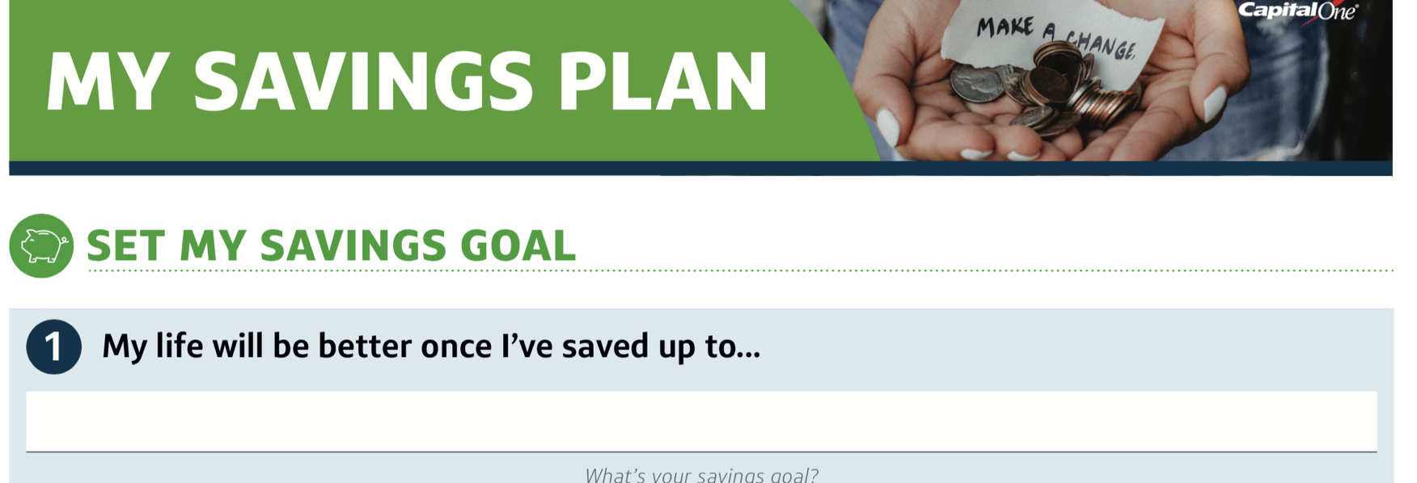
MY SAVINGS GOAL
1
The number on the slide matches a number on your Savings Plan.
7m
Notes:
TIME: 1 min 0:07
We are going to start by sketching the first step in our plans. This is not going to be an easy 3-step plan. For the next 40 minutes we will be working on creating concrete plans, getting specific, learning from each other, planning for obstacles and setting reminders. We are going to work hard, but we are going to g through this together.
The first things you’ll need are a pen/pencil and a blank paper. Once you find that, Make sure to write “MY SAVINGS PLAN” on the top of your paper.
By the end of this workshop you will all have created a savings plan. This will be YOUR savings plan, so make sure to be honest. To help guide you we have matched the numbers on the top left of our slides to the step that we will be working on.
We are planning for success here, and to do that we have to redefine how we think about success and how we think about savings.
If there is anything that this crisis has taught us- is that you are never too prepared for the unexpected- but boy does it help to have some cushion available for when you need it.
If you do not have income right now, please use everything we will discuss as a tool …

Slide 9
WHAT’S YOUR SAVINGS GOAL?
1
Choose a goal…
One single goal
That you can picture clearly
That is possible because you save
…then envision success. How will you feel? Where will you be, and what will you be doing? How will the people you love feel? Picture it as clearly as you can!
9m
Notes:
TIME: 2 min 0:09
The first thing you’re going to do is to pick a goal: what do you want to save for?
It’s not about how much you save, it’s about what you’re saving for.
Here are a few things to keep in mind:
Choose one single goal - If you have many goals, pick the one that feels the most important to you.
It should be something you can picture clearly.
For example, __________________ (If you want to save for an emergency fund), ask yourself __________________ (what kind of problems can it protect you from)?
Or if __________________ (you want to move out), think about __________________ (what kind of place do you want to move to)?
Make it a goal that’s possible because you save:
You’re looking for a savings goal, like __________________ (buying a new computer), and not a life goal like __________________ (getting a new job).
Although, life goals often require savings goals.
[NOTES CONTINUE ON NEXT PAGE]
Then, you’ll take a moment to picture this as realistically as you can.
How will you feel once you reach your goal?
Where will you be? What will you be doing? Who else will be there? What will they be doing? How will the people you love feel?
For example, __________________ (Picture yourself in that new apartment. Where will you be sitting?)
“Let’s look at an example…”

Slide 10
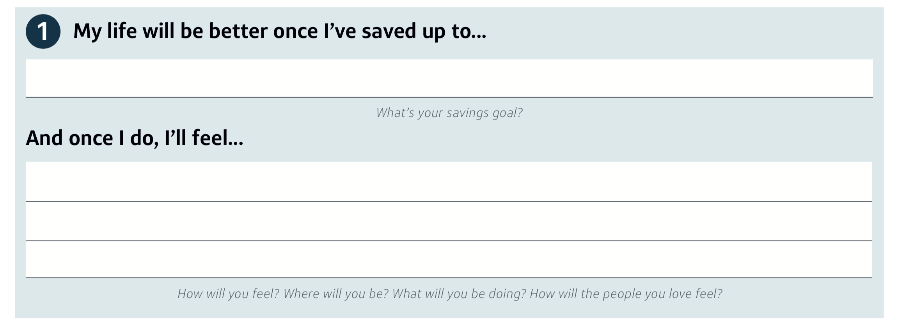
WHAT’S YOUR SAVINGS GOAL?
1
In Section #1 on your Savings Plan, write your goal and your vision…
Pay for repairs to my car
less stress in the mornings about getting to work on time. If I can take my car, instead of the bus, I’ll have more time to eat with my kids.
11m
Notes:
TIME: 2 min 0:11
Maybe your goal is to __________________ (take a family vacation to someplace relaxing)
Once you achieve this, you might imagine yourself __________________ (relaxing at your kitchen table at the end of the day, talking with your parents while your kids are playing happily in the yard)
[Presenter Note: Give them ~1.5 min to complete this step]
Take a moment to write this on your paper.
“Has everyone written down their goal? Let’s talk about it.”

Slide 11
SAVINGS GOALS
Discussion:
What goal did you choose?
What did you picture?
3 min
14m
Notes:
HOST:
We want to hear what goals you chose and perhaps a summary of what you envisioned. Please use the chat function to tell us a little bit about your goal.
You don’t have to, but if you’re able to you might spur or inspire ideas in someon
e else.
What goal did you choose?
What would it feel like, once you’ve reached that goal?
You can update your goal at any point if you’ve had new ideas. Go ahead!
“Okay, so how do we get ourselves there?”
FAE Notes:
- Facilitate this as a classroom discussion. Be supportive; encourage sharing but don’t force it; ask open-ended questions; start to probe about why that goal is important and what it feels like to them.
- Nudge them toward goals that are single (not multiple), specific (not general), savings goals (not life goals); less than a year away (encourage them to find a milestone)

Slide 12
HOW OFTEN CAN YOU SAVE?
2
The best time to save is when the money comes in.
Do you get a regular paycheck? Save when it comes in: every week, 2 weeks, or month
Do you get paid less regularly? Save a little every week
15m
Notes:
TIME: 1/2 min 0:15
The best time to save is right when the money comes in.
If you get a paycheck every two weeks, save every two weeks
If you get a check every month, save every month.
If you don’t have a regular income, try to save every week.
If you have a direct deposit paycheck, the best way to save is to automatically divert some of that into a savings account
Be careful not to incur overdraft fees
“For example...”

Slide 13
HOW OFTEN CAN YOU SAVE?
2
For part 2, write how often you want to save…
2 weeks
15m
Notes:
TIME: 1/2 min 0:15
So, if my income comes in __________________(every two weeks), I’ll write that.
Don’t worry about how much to save yet.
Now, you write down your answer in blank #2
Does anyone have a question?
[Presenter Note: Give them ~30 seconds to complete this step]
“Next, let’s think about how much we can easily save.”

Slide 14
HOW MUCH IS EASY TO SAVE?
3
How much money can you easily save in the amount of time you just chose?
It’s okay if it’s small.
This should be comfortable for you!
16m
Notes:
TIME: 1/2 min 0:16
Now in that timeframe that you just chose, how much could you easily set aside?
WThink of it like this: how much money could disappear from your wallet, and it wouldn’t be a huge burden?
Optional: How much could you save without making a large sacrifice?
Optional: It’s better to set an easy goal and make it, than to set a hard goal and miss it.
“So, for example…”

Slide 15
HOW MUCH IS EASY TO SAVE?
3
For part 3, write how much you can easily save…
$ 5
OR
$ 20
OR
$ 50
16m
Notes:
TIME: 1 min 0:16
I might feel comfortable saving _______ ($5) every week, or _______ ($20) a month, or _______ ($50), or more.
AEven if I can just save $5 right now, that’s totally okay. There is no right or wrong amount, this is whatever works for you.
Take a minute to write this on your plan
[Presenter Note: Give them ~1 min to complete this step]
“Now, how fast does that add up?”

Slide 16
HOW MUCH DOES THAT ADD UP TO?
4
After a year, how much will you have?
✖️
50 Weeks =
17m
Notes:
TIME: 1/2 min 0:17
Even though you picked something easy, this will add up fast!
“For example...”

Slide 17
HOW MUCH DOES THAT ADD UP TO?
4
In Section 4, multiply the amount you chose to save…
If you chose a weekly goal => multiply it by 50 It’s easier if you multiply by 5, then add a 0 to the end
If you chose every 2 weeks => multiply it by 25 Do the math above, and then cut the number in half
If you chose a monthly goal => multiply it by 10 Add a zero at the end of your savings amount
Every week | Yearly Total
$5 | $250
$10 | $500
$20 | $1,000
$50 | $2,500
$100 | $5,000
$150 | $7,800
20m
Notes:
TIME: 3 min 0:20
Multiply the amount you chose to save in (step #3).
You can use the calculators on your phones – but don’t get distracted by your text messages!
If you chose a weekly goal => multiply by 50 [It’s easier if you multiply by 5, then add a 0 to the end]
If you chose every 2 weeks => multiply by 25
If you chose a monthly goal => multiply by 10
The table on the left shows some of the sums for weekly savings amounts
You may have noticed that there are 12 months in a year, not 10 – that’s because these numbers don’t have to be exact because you’ll probably miss a deposit or two. That’s totally okay!
Does anyone have a number that’s not on this table?
Take 2 minutes to write in step#4
Please make sure to write this on your plan!
[Presenter Note: Give them ~2 min to complete this step]
“Do these numbers feel too high? Too low?”

Slide 18
Set yourself up for success.
People often try to do too much when they start.
Does this amount feel realistic?
If not, adjust it.
21m
Notes:
TIME: 1 min 0:21
It’s easy to be really optimistic about how much we can save, and that makes it much harder to get started. The best way is to start with an easy, realistic amount and get yourself an early win.
Take a moment to double check if this amount feels manageable.
If the number you end up with feels too high => make it smaller
If it’s not getting you to to your goal fast enough => make it bigger
…just make sure it’s still easy
Take a minute to adjust your goal [FAE Note: Pause to allow time]
“So, how are we going to find those savings?”

Slide 19
WHAT ARE SOME WAYS TO REDUCE COSTS?
5
What are some ways to reduce costs and find savings?
We’ll think of some ways to…
Shop around for frequent purchases
Find cheaper or free alternatives
Avoid fees
Unsubscribe
And more…
Avoid picking things that will be too difficult to do!
23m
Notes:
TIME: 2 min 0:23
Here are a few rules for brainstorming:
Be specific!
For example, instead of __________________ (save money on groceries), write down __________________ (buy more frozen veggies, because they don’t go bad)
Try to find things that don’t require too much sacrifice.
For example, __________________ (Quitting smoking or ‘just saying no’ to your kids) is really hard. So try to find something easier!
Come up with as many ideas as you can.
If you run out of space, write anywhere on the bottom of the paper.
Write down new Ideas and ideas that have worked for you in the past.
[NOTES CONTINUE ON NEXT PAGE]
Shop around for frequent purchases?
What do you buy a lot, that is cheaper somewhere else?
For example, __________________ (Getting groceries at a cheaper grocery store // Checking prices online // Lowering your cable, phone or internet bill // Using a gas price app // Using price comparison apps like Honey or Wikibuy // Asking Big Box stores to match online prices)
Find Cheaper or Free Alternatives:
ASomething you spend money on that you could experience for less $$.
Make sure you’re replacing the real value, don’t just take things away from yourself.
For example, __________________ (Instead of dinner out with friends, do potlucks // instead of renting DVDs, get them from the library on your way home)
Does anyone have an example?
Avoid Fees:
For example, how could you avoid __________________ (Credit card fees, Parking tickets)
What’s an example of this?
Unsubscribe:
For example, __________________ (magazines // apps // gym membership, but only if you don’t use it)
Someone give me an example – what could you unsubscribe from?
Other Ways to Save?
Ex: _____________________________________________
Examples: Shop with your hands; Combine errands into single trips to save gas
Does anyone have an example?

Slide 20
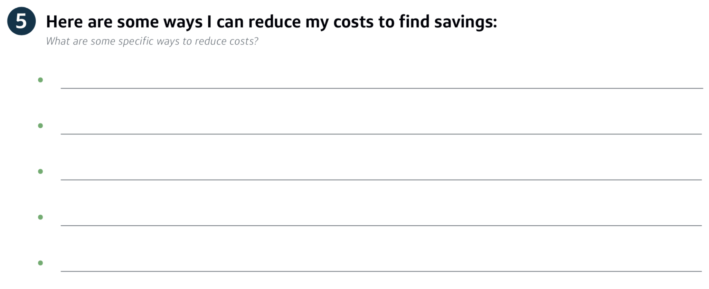
WHAT ARE SOME WAYS TO REDUCE COSTS?
5
For Step 5, brainstorm on your own, and be as specific as you can!
Use a coupon or coupon app
Get groceries at a cheaper store
Find free activities to do with friends/family
Reduce my cable subscription
Cook extra dinner + bring it for lunch
25m
Notes:
TIME: 2 min 0:25
Now take 2 minutes, and write down any examples you can think of.
Remember to be specific!
[Presenter Note: Give them ~2 min to complete this step]
“Okay, let’s talk about it.”

Slide 21
WAYS TO SAVE
Discussion in breakout rooms:
What are some ways to reduce costs that you thought of?
Write down any ideas that might work for you!
4 min
32m
Notes:
HOST :
In a moment I will be splitting you into breakout rooms where you can discuss tactics that you plan to use or have used to reduce debt. We have heard participants that get really creative with this step and we invite you to do the same.
Once you are in your breakout room, your lines will no longer be muted and you will be able to speak to others in your group. I will be dropping into your rooms to see how discussions are going and to answer any questions you might have this step.
As you’re talking, write down any ideas you like! It’s not stealing.
Visit groups
Bring everyone in full group a
What ideas did you come up with?
“These were some excellent ideas. So, what should we get to first?”

Slide 22
WHAT’S EASY & HAS IMPACT?
6
Of the ideas you just discussed, which one is the best fit for you?
Easy
Cuts your costs meaningfully
using grocery store coupons for items I need to buy regularly
33m
Notes:
TIME: 1 min 0:33
From all these ideas in step 5, which one fits you best?
Pick the idea that balances:
Big savings (choose something that makes significant progress toward your goal)
Small sacrifice (you may have to give up something, but if it really hurts, you probably won’t do it)
Is likely to happen (e.g. doesn’t rely on someone who is unlikely to agree)
Does anyone have a question?
[Presenter Note: Give them ~30 seconds to complete this step]
“Let’s make a plan.”

Slide 23
HOW DO I BREAK IT DOWN?
7
Break it down into two specific steps.
For each step, answer the following:
Where will I do this?
When can I do this ?
Who could help me do it?
34m
Notes:
TIME: 1 min 0:34
Break this action down into two separate steps and answer a few questions:
Where will I do it?
On what day and what time will I do it?
Could I get anyone else to help me?

Slide 24
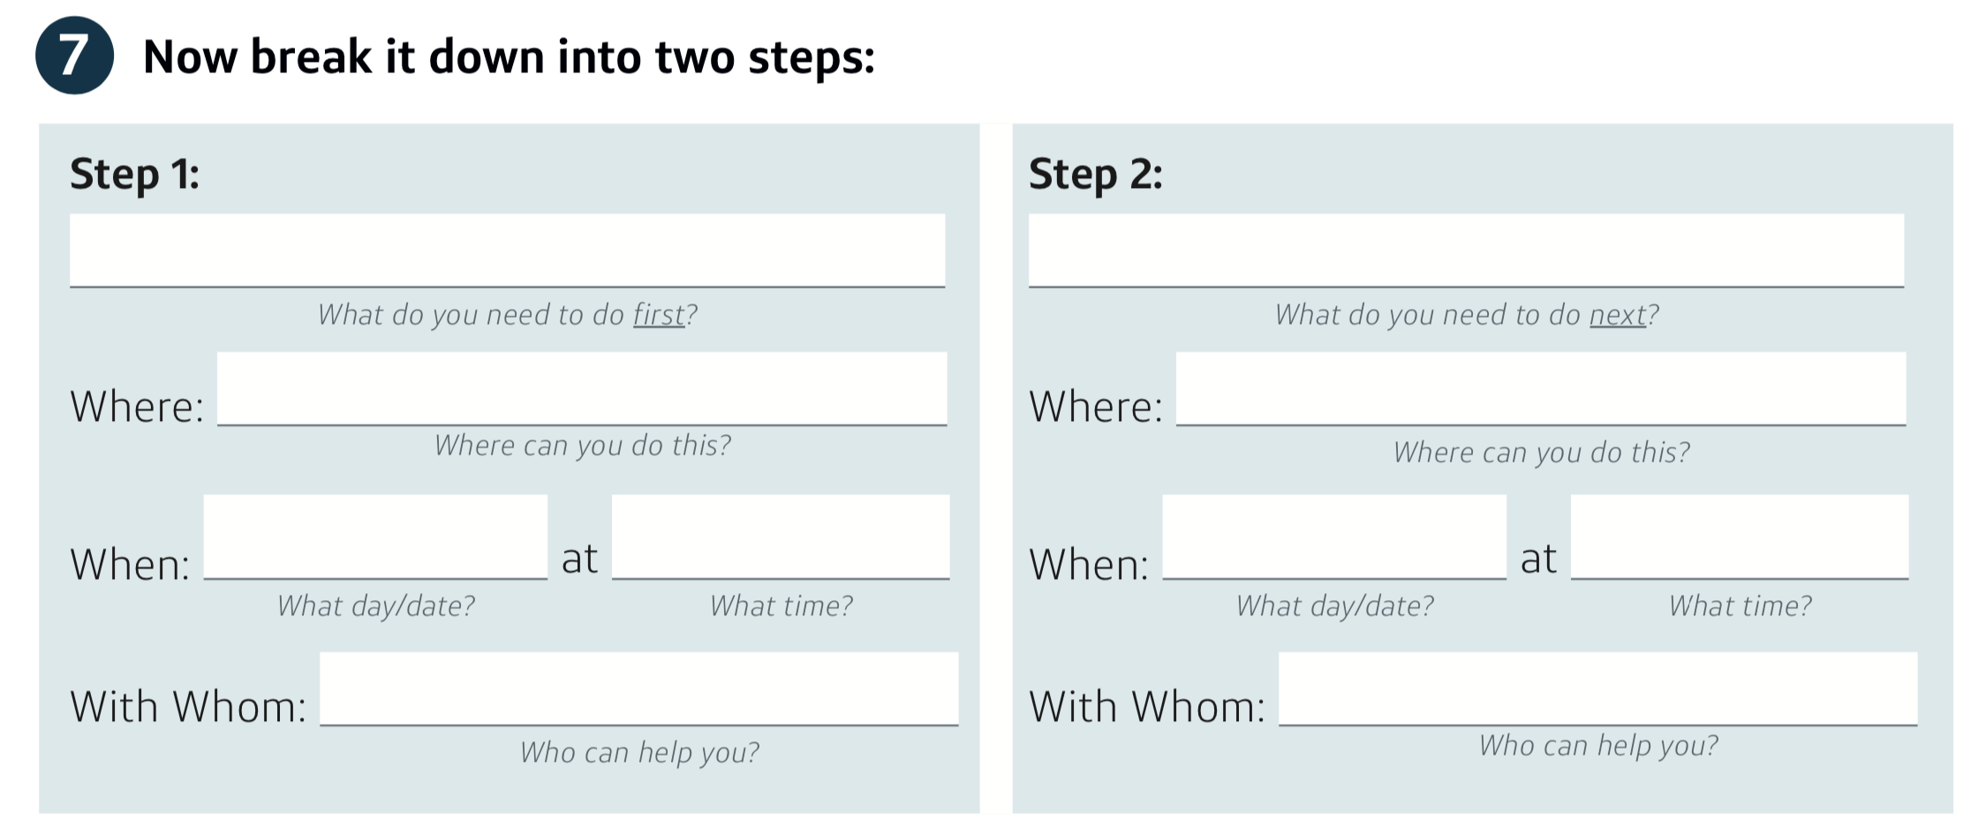
HOW DO I BREAK IT DOWN?
7
For step #7, break that action into two steps…
Find coupons for items I need
Find + buy items using these coupons
On my couch, while watching TV
Walmart on Main St
Thurs
9pm
Sunday
4pm
My sister
My kids
38m
Notes:
TIME: 4 min 0:38
For example, if the savings action I chose is __________________ (to use coupons more for groceries),
then my first step could be __________________ (find coupons for items I need, and put them in my wallet)
and my second step could be __________________ (remember to use them when I get to the cash register)
and then I decide where, when, and with whom I’m going to do it.
If your action doesn’t have smaller steps, think of two things you could do to make it easier for yourself
For example,
if the savings action I chose is __________________ (to make a deposit every Friday after work),
then my first step could be __________________ (set myself a reminder alarm for the time I normally leave work)
and my second step could be __________________ (if I make the deposit, I’ll treat myself to an ice cream at the place next door to the bank)
Now take a few minutes and fill out your steps.
[NOTES CONTINUE ON NEXT PAGE]
Does anyone have a tricky example? [Help them to walk through the example]
Does anyone want to share?
[Presenter Note: Give them ~3 min to complete this step]
“And now that we’ve got a good plan to free up some money, what do we do with it?”

Slide 25
HOW DO I KEEP THE MONEY ASIDE?
8
For Step#8, write down when and where you’ll deposit that savings amount…
25
Sunday at 5p on my way home
the bank next to the grocery store
41m
Notes:
TIME: 3 min 0:41
Let’s put it all together.
Write down the amount you’re going to save each time
And now write down when you’ll save it
And where you’re going to save it
This should be somewhere safe, and a bank is often the safest place.
If you have a savings account already, make a deposit there!
If you’d prefer to save at home, make sure to keep your money in a safe, secure location.
As a reminder, if you have a direct deposit paycheck, the best way to save is to automatically divert some of that into a savings account
Take a few minutes to write out your plan
[Presenter Note: Give them ~2 min to complete this step]
“But sometimes life throws us curveballs.”

Slide 26
Things don’t always go according to plan.
Make a backup plan in case something gets in the way.
42m
Notes:
TIME: 1 min 0:42
Despite our best intentions, things don’t always go according to plan
Remember that setbacks aren’t failures. You just have to get started again.
“So, let’s make a back-up plan.”

Slide 27
WHAT’S MY BACKUP PLAN?
9
Look at the plan you wrote.
What is likely to get in the way of your steps?
What can you do to complete your steps if that happens?
Write down one likely problem, and a back-up plan that feels realistic.
43m
Notes:
TIME: 1 min 0:43
Look back at the other sections on this page, and your plan.
First, you’ll close your eyes and picture the problems that could get in your way.
Then, picture some solutions.
Keep in mind that there are a few ways to solve a problem:
You can prevent an obstacle
You can solve it if it happens
You can recruit someone to help you
…or if end up with a problem you can’t solve, maybe you need to go back and update your goal. That’s okay.
“For example…”

Slide 28
FILL OUT YOUR BACKUP PLAN
9
In Section #9, write down an important or likely problem, and a back-up plan…
I work late on Thursday and don’t have time to find coupons
find coupons on Sunday before I go to the store
46m
Notes:
TIME: 3 min 0:46
For example, maybe __________________ (I want to use those coupons)
But there could be a problem if __________________ (I forget that the coupons are in my wallet)
So then a solution could be __________________ (I’ll put them in the same slot as my money)
Take a minute to write down a likely problem, and a back-up plan in step #9.
[Presenter Note: Give them ~2 min to complete this step]
“Has everyone written down their back-up plans?”

Slide 29
PROBLEM SOLVING
Discussion:
What are some things that could get in the way of the steps in your plan?
What is your backup plan?
3 min
49m
Notes:
HOST: Encourage chat function 0:49
Does anyone want to share some of the back-up plans they thought about?
You don’t have to, but if you’re able to you might spur or inspire ideas in someone else.
“And what if we find a problem we can’t solve?”

Slide 30
REMEMBER: Setbacks are NOT failures!
If you need to spend your savings before you reach your goal, that’s okay.
Just start saving again.
50m
Notes:
TIME: 1 min 0:50
It’s okay to miss some deposits.
Using your savings for an important emergency is a success, as long as you start saving again after.
Examples: Maybe you’re saving for your car repairs, but your kid needs books for school. That’s okay.
Ex: _____________________________________________
Ex: _____________________________________________
“But life is busy, isn’t it? How are we going to remember?”

Slide 31
SET MY REMINDERS
10
Use a reminder app or set one through your phone calendar.
Write down your steps on a paper calendar.
Take a picture of your plan and set it as the lock screen on your phone.
Write on the sticker and put it somewhere you’ll see it, like your bathroom mirror or your wallet.
In Section #10, write where you’ll put your reminder…
On my mirror
54m
Notes:
TIME: 3 min 0:54
On my phone, I would make a calendar reminder to do so on the exact date or time.
Set reminders for your action steps (#7) and your first first savings deposit (#8)
[Presenter Note: Give them ~3 min to complete this step]
“That’s it! Now look back at how much progress you’ve made today.”

Slide 32
You Made a Lot of Progress Today!
TODAY’S ACCOMPLISHMENTS
Chose a Savings Goal
Found Strategies
Made a Plan
NEXT STEPS
Take Your Savings Steps
Make Your Deposits
55m
Notes:
TIME: 1 min 0:55
Today, we…
Chose a savings goal
Found strategies to cut costs in our lives
And made a plan for how we’re going to save
You’re all walking away better equipped to generate savings towards your goals.
Next, you’ve got to take those steps to free up those savings
And then make your deposits!
If extra time is available, do a discussion:
“What is everyone’s first step going to be?”
“Thank you all for your hard work today.”
HOST: “Before we say our farewells and share final thoughts, we would love to get your feedback about today’s presentation. As you might imagine, this workshop is usually done in person. The virtual space is something that we continue to learn from. I will include a link on the chat function where you can fill out a survey. Your responses will be anonymous. Please take two minutes to fill out the survey.”
link: https://docs.google.com/forms/d/e/1FAIpQLSfzJ0eGJbaeg5sdBPkSKkLEFp_tfB_08SYImK-gm7fDngBbMw/viewform

Slide 33
Congratulations on Creating Your Plan!
Please Complete the Survey
58m
Notes:
TIME: 3 min 0:58
You’ve put a lot of thought in today, and that’s half the batte!
And finally, we have a survey to help us continue to improve this workshop. Please let us know what you liked, and what could be better. [Pass out the survey]
https://docs.google.com/forms/d/e/1FAIpQLSfzJ0eGJbaeg5sdBPkSKkLEFp_tfB_08SYImK-gm7fDngBbMw/viewform?usp=sf_link
“Congratulations on your hard work today, and the progress you made! Good luck making your first savings deposit!”

